Slide 1
Namas Crystal
Crystal E-commerce Platform
Team 29

Slide 2
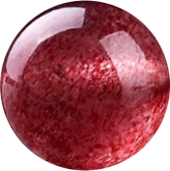
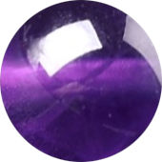
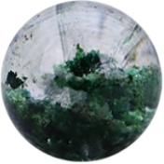
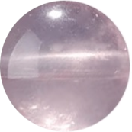
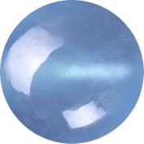
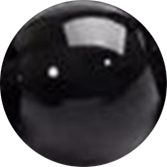
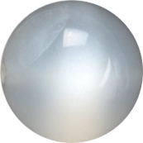
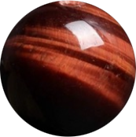
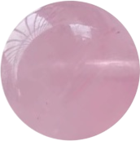
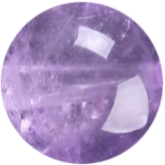
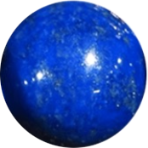
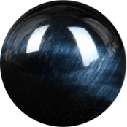
Background
Namas Crystals is a personalized e-commerce platform specializing in crystal accessories. Our goal is to blend spiritual elements with a modern shopping experience, allowing users to discover and customize crystal products tailored to their unique characteristics and preferences. Project Objectives
Seamless Shopping Experience: Enable a smooth flow from browsing to payment.
Customization Feature: Allow users to design their own crystal accessories
Personalized Recommendations: Provide crystal suggestions based on users’ personality traits and preferences.
Inspiration and Motivation
Unique Shopping Experience: In recent years, interest in spiritual well-being and personalized products has surged, with more people seeking unique items that resonate with their individuality and beliefs.
Personalized Product Discovery: Unlike traditional e-commerce sites, Namas Crystals goes beyond basic recommendations. We aim to provide a deeply personalized experience where each crystal suggestion aligns with users’ unique traits
Notes:
whether for enhancing energy, promoting relaxation, or fostering spiritual growth.

Slide 3
Technical Details
Pages:
Register + Login Page
Home Page
Item Page (Necklaces, Bracelets, Rings)
Product Detail Page
Cart Page
Payment Page
Customization Page
Navigation Bar + Footer
Other Flows:
User Management: create account, anonymous browsing, login (OAuth)
Cart Management: add item, delete item, modify quantity, checkout
Payment Management: Stripe API (Shipping address suggestion/validation, payment method management, fraud prevention)
Technical Tools:
Frontend: React (Javascript -> Typescript), Tailwind (CSS)
Backend: Django, MySQL
Optional Features:
Review after purchase
Chatbot
Collaborative customization design

Slide 4
Completion
Mainly focused on backend for this sprint
Black: what we already completed
Red: backlog for the next sprint
Home Page | Feature Image (Maybe use Slider) | Users can view sliding images that display featured products or promotions.
 | Card Design for Different Categories - Find Your Crystal - New Arrivals - Best Sellers - Customize | A visually engaging interface that helps users quickly know about different categories. There will be several items displayed as a clickable card for each category.
Item Page - Bracelets - Necklaces - Rings | Items List (images, names, and pricing details） | Users can browse through all available bracelets, and navigate to the product details page.
 | Filter | A filter tool to refine the list of products based on price, crystal type, material, or other attributes.
 | Sort By | A sorting tool to arrange products based on price, popularity, or new arrivals.
Product Detail Page | Description | Images, description, and details about the product
 | Add to Cart | The button that add the product to the cart

Slide 5
Completion
Black: what we already completed
Red: backlog for the next sprint
Customize | Bracelet - choose the crystal - arrange the bracelet | Users can select from a variety of available crystals, arrange and combine crystals in a bracelet according to their design preferences.
About Us Page | Our History
User Profile Page | Lookup/edit user info - Change address - Reset password - History orders | Users can check and modify their info, and lookup order status.

Slide 6
Completion
Black: what we already completed
Red: backlog for the next sprint
User Management | Create Account | Create new account to checkout
 | Anonymous Browsing | Browse items without login
 | Login | Simple Auth & OAuth
Cart Management | Add Item | Users can add item to their cart (from product page)
 | Delete Item | Users can remove items in their cart.
 | Modify Quantity | Users can edit quantities of items in their cart.
 | Checkout | Users can checkout
Payment Management | Redirect to Stripe API | Checkout and manage payment using Stripe API
 | Link Stripe to the database | Store user info collected from Stripe to our own DB

Slide 7
Demo
http://localhost:5173/

